Slide 1
Digital Communication 22EC2208
Pulse Code Modulation
Dr. M. Venu Gopala Rao
A.M.I.E.T.E, M.Tech, Ph.D(Engg)
Cert. in R.S.T ( City & Guild’s London Institute, London)
F.I.E.T.E, L.M.I.S.T.E, I.S.O.I., S.S.I., M.I.A.E.
Professor, Dept. of ECE, K L University
mvgr03@kluniversity.in

Slide 2
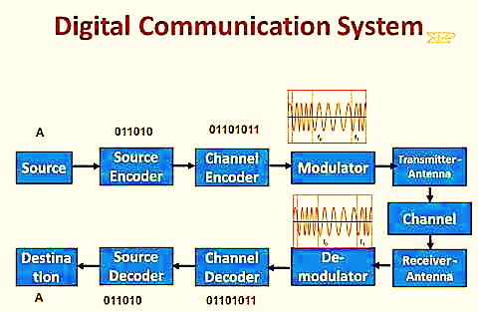

Slide 3
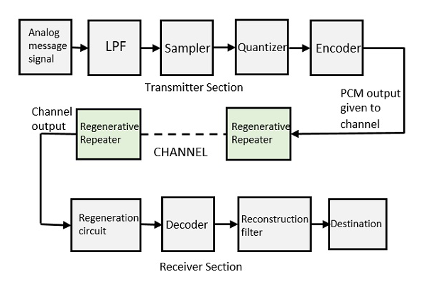

Slide 4
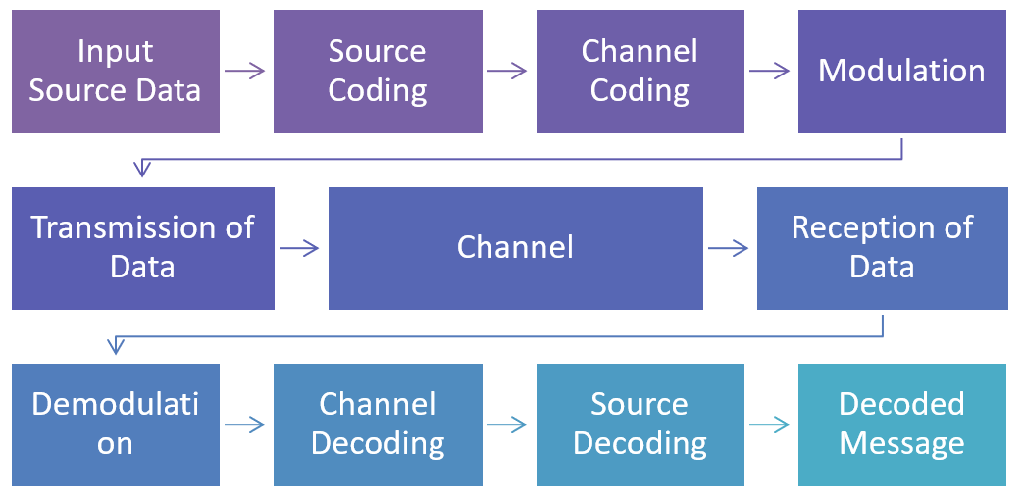

Slide 5
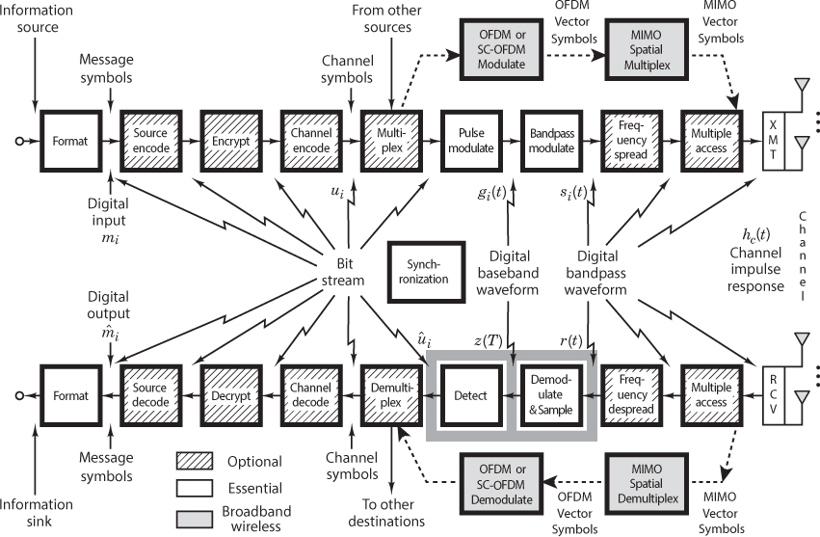

Slide 6
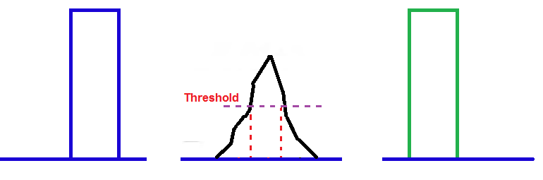
Advantages of Digital Transmission
The primary advantage of digital transmission over analog transmission is noise immunity.
Digital signals are inherently less susceptible than analog signals to interference caused by noise, because with digital signals it is not necessary to evaluate the precise amplitude, frequency, or phase to ascertain its logic condition.
Instead, pulses are evaluated during a precise time interval, and a simple determination is made whether the pulse is above or below a prescribed reference level.

Slide 7
Digital communication systems are cheaper to implement, because of the advancement of VLSI technology.
Digital signals are better suited than analog signals for processing and combining using a technique called multiplexing.
It is much simpler to store digital signals than analog signals, and the transmission rate of digital signals can be easily changed to adapt to different environments and to interface with different types of equipment.
Digital transmission systems are more resistant to analog systems to additive noise because they use signal regeneration rather than signal amplification.
digital regenerators sample noisy signals and then reproduce an entirely new digital signal with the same signal-to-noise ratio as the original transmitted signal. Therefore, digital signals can be transported longer distances than analog signals.

Slide 8
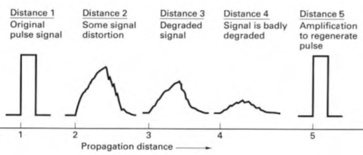
Regeneration of PCM signal

Slide 9
Digital signals are simpler to measure and evaluate than analog signals. Therefore, it is easier to compare the error performance of one digital system to another digital system.
Also, with digital signals, transmission errors can be detected and corrected more easily and more accurately than is possible with analog signals
Disadvantages of Digital Transmission
The transmission of digitally encoded analog signals requires significantly more bandwidth than simply transmitting the original analog signal.
ADC and DAC are needed
Requires precise time synchronization between the clocks in the transmitters and receivers
Digital transmission systems are incompatible with older analog transmission systems

Slide 10
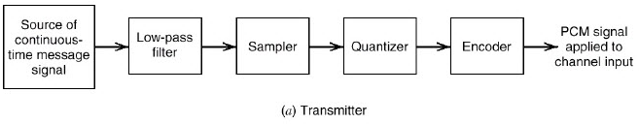
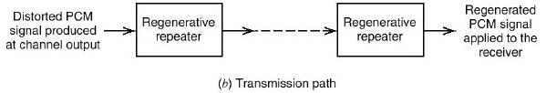
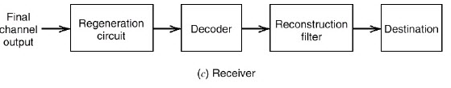
Pulse Code Modulation
Pulse code modulation (PCM) is a digital transmission system with analog to digital converter (ADC) at the input and a digital to analog converter (DAC) at the output.

Slide 11
Practical Sampling Rates
Speech
- Telephone quality speech has a bandwidth of 4 kHz (actually 300 to 3300Hz)
- Most digital telephone systems are sampled at 8000 samples/sec
Audio:
- The highest frequency the human ear can hear is approximately 15kHz
- CD quality audio are sampled at rate of 44,100 samples/sec
Video
- The human eye requires samples at a rate of at least 20 frames/sec to achieve smooth motion

Slide 12
Regeneration of PCM signal

Slide 13
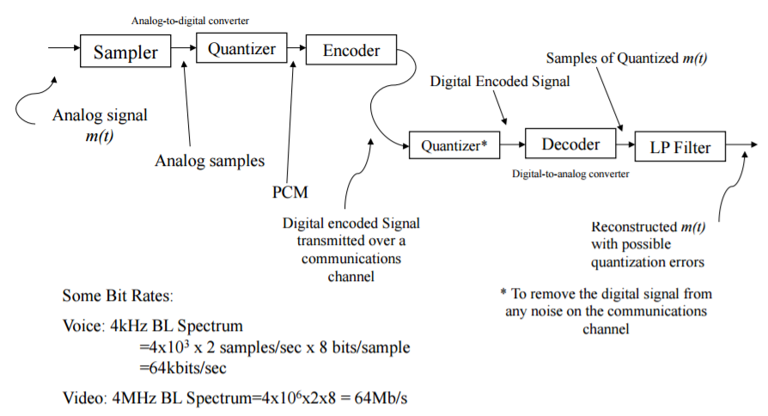
A PCM System
DT sequence

Slide 14
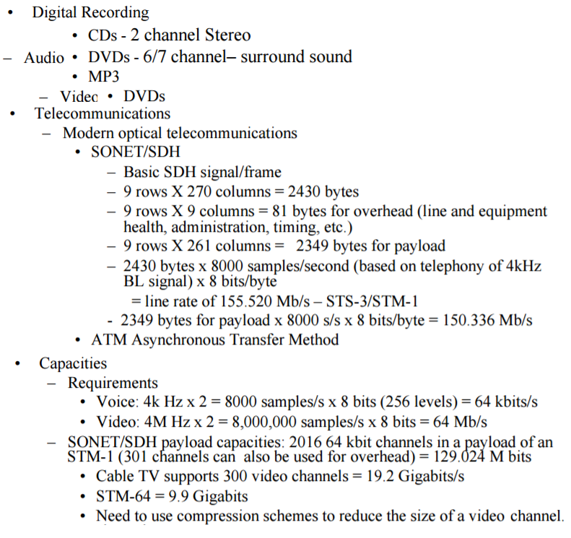
Examples of PCM

Slide 15
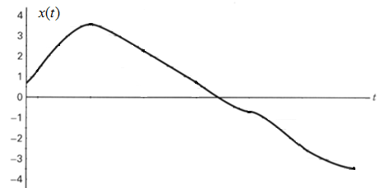
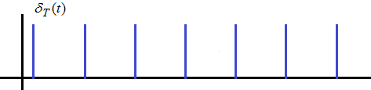
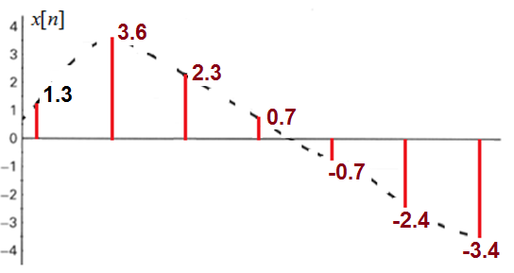
Sampling
x[n] = {1.3, 3.6, 2.3, 0.7, -0.7, -2.4, -3.4 }

Slide 16
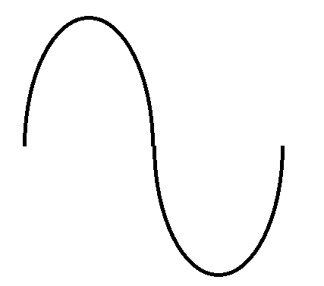

Slide 17


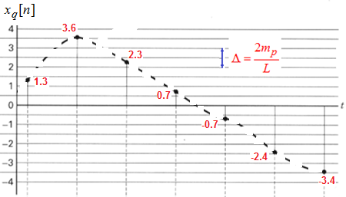

Quantization and Encoding

Slide 18
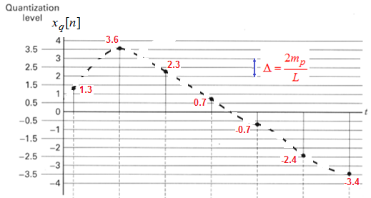
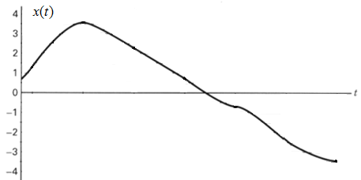
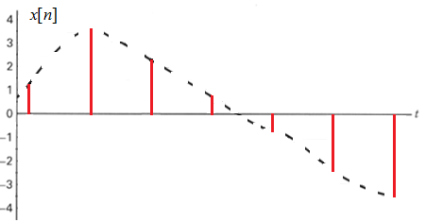

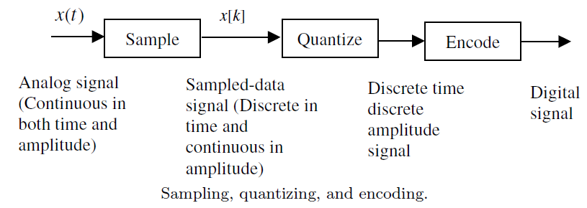
Sampling, Quantization and Encoding

Slide 19
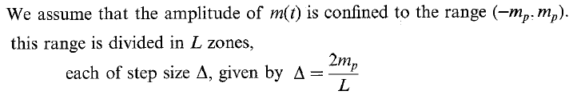
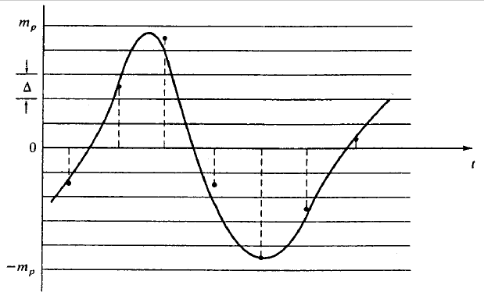

Uniform Quantization
$$L=2^{n} \text{or} n=\log_{2}L bits$$

Slide 21
Quantization and Encoding

Slide 22






Assigning PCM codes to absolute magnitudes is called Quantizing.
The magnitude difference between adjacent step is called the quantization interval / quantum.
The magnitude of the quantum is also called the resolution.
The resolution is equal to the voltage of the minimum step size = Voltage of LSB.

Slide 23
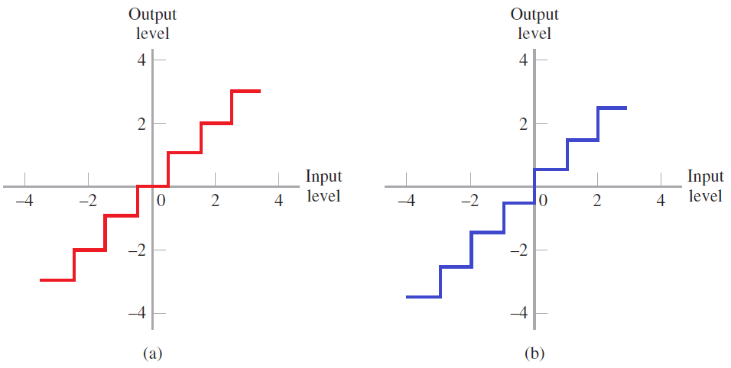
Midtread and Midrise Quantizer Characteristics

Slide 24
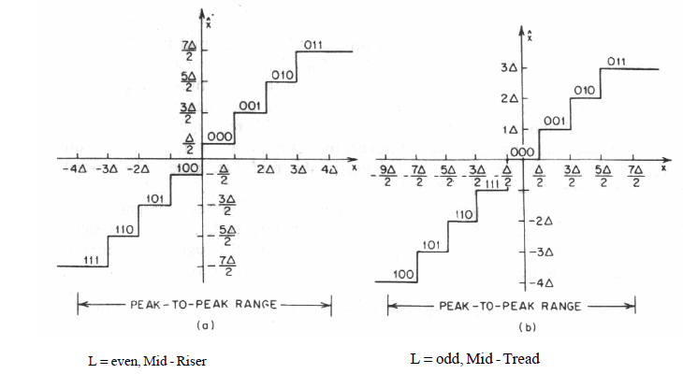

Slide 25
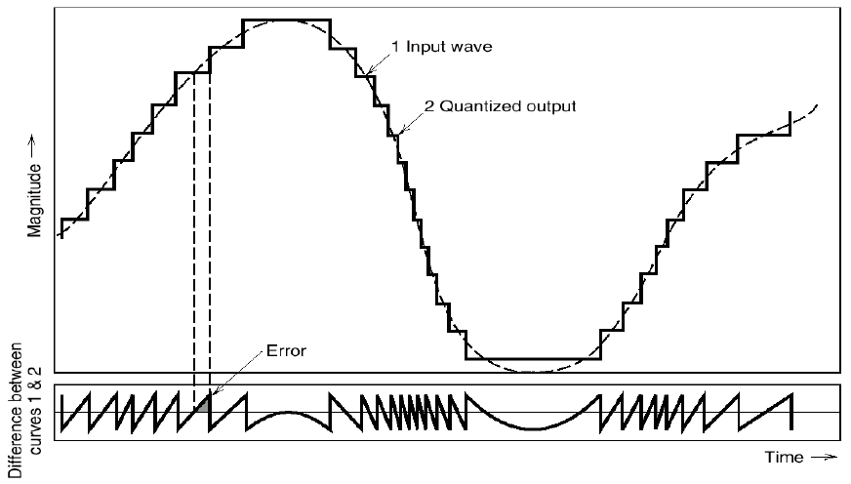
Quantization Error

Slide 26


Ex1: Quantize a sequence {1.2, -0.2, -0.5. 0.4, 0.89, 1.3} using a uniform quantizer in the range of (-1.5. 1.5) with (i) Four levels (ii) Eight levels, and write the quantized sequences. Determine the quantization error in each case. Write the encoded sequence. Find the full scale accuracy. Find the percentage accuracy.
The full scale accuracy
The percentage accuracy

Slide 27
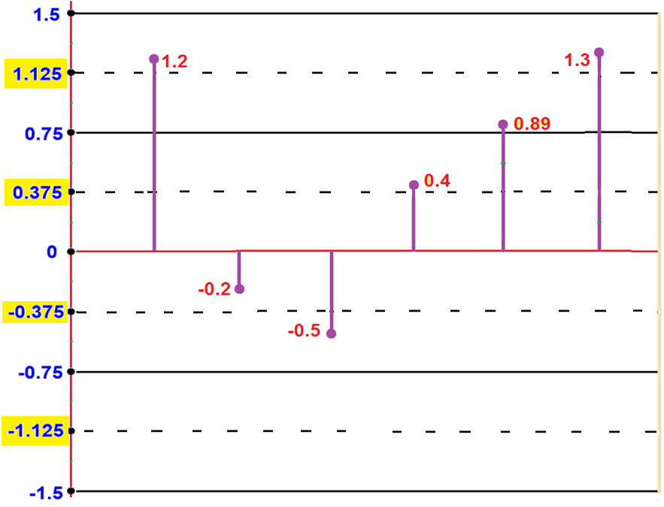



Given Sequence
{1.2, -0.2, -0.5, 0.4, 0.89, 1.3}
1.125
1.125
11
0.125
10
0.375
01
-0.375
-0.375
00
Bit stream representing Encoding: 11 01 01 10 11 11

Slide 28



Ex1: Quantize a sequence {1.2, -0.2, -0.5. 0.4, 0.89, 1.3} using a uniform quantizer in the range of (-1.5. 1.5) with (i) Four levels (ii) Eight levels, and write the quantized sequences. Determine the quantization error in each case. Write the encoded sequence
(i) For L = 4;
Therefore the quantization error
codewords 00 01 10 11
Quantization levels = { -1.5, -1.125, -0.75, -0.375, 0, 0.375, 0.75, 1.125, 1.5 }
Given Sequence {1.2, -0.2, -0.5. 0.4, 0.89, 1.3}
Therefore the quantized sequence {1.125, -0.375, -0.375, 0.375, 0.125, 1.125}
Bit stream representing Encoding: 11 01 01 10 11 11

Slide 29

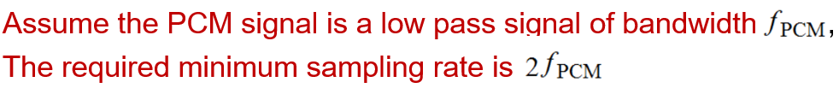
Bandwidth of PCM

Slide 30

Bandwidth of PCM…

Slide 31







Formulas

Slide 32

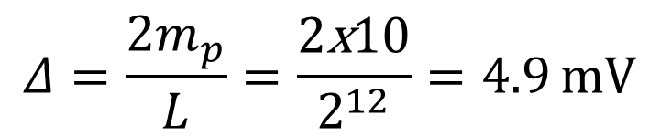

Ex: Consider a 12 bit uniform quantizer with input range of Volts.
Calculate the step size and maximum quantization error.
Therefore maximum quantization error
$$Δ=\frac{2m_{p}}{L}=\frac{2\text{x}10}{2^{12}}=4.9 \text{mV}$$
$$\frac{Δ}{2}=2.45 \text{mV}$$

Slide 33
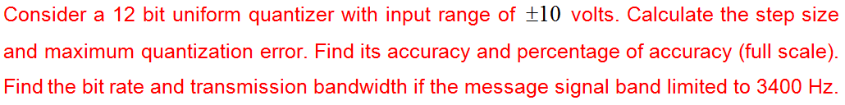







Slide 34
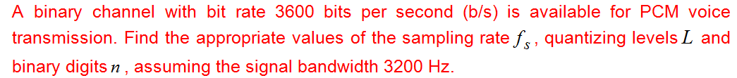


Slide 35


Slide 36
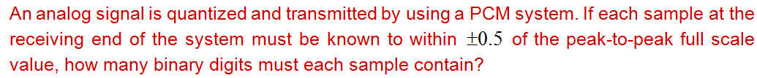
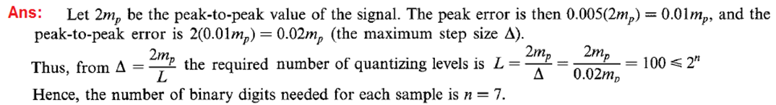

Slide 37
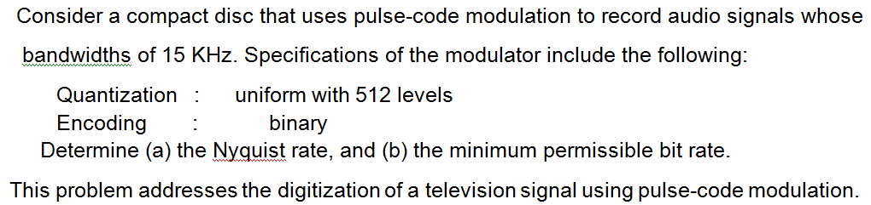
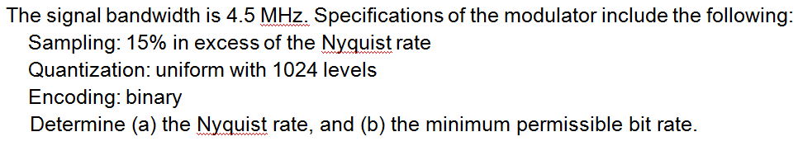

Slide 38
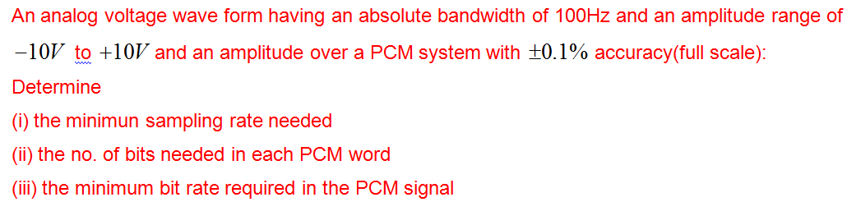
Sampling rate 200Hz
Min.bit rate = (No.of bits)*(sampling rate) = 14*200 = 2800 bits/sec

Slide 39
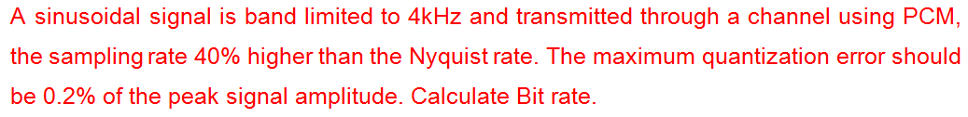
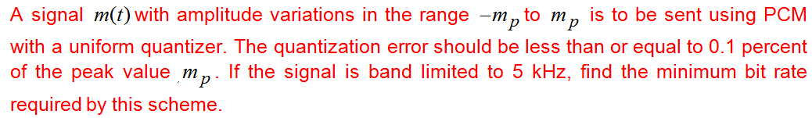


Slide 40
Noise consideration in PCM system
The performance of a PCM system is influenced by two major sources of noise.
Channel noise: which is introduced anywhere between the transmitter output and the receiver input, channel noise is always present, once the equipment is switched on.
2. Quantization noise, which is introduced in the transmitter
and is carried all the way along to the receiver output.

Slide 41
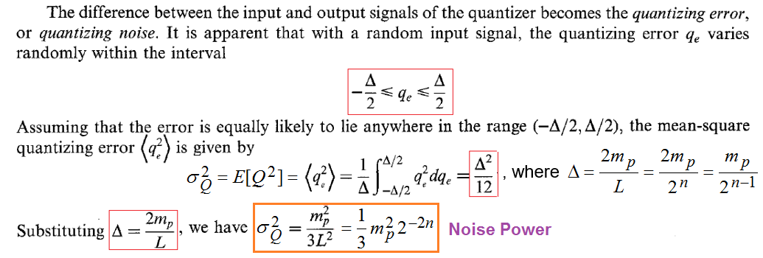
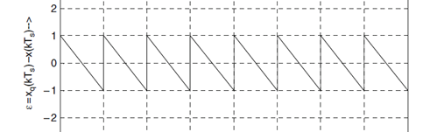
Quantization Error and Noise Power

Slide 42
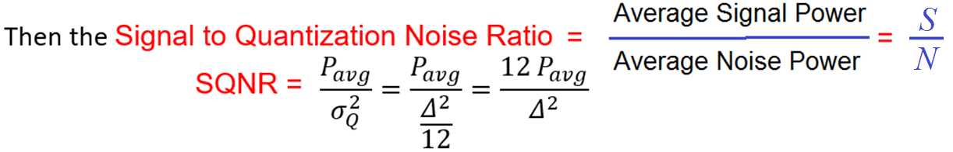
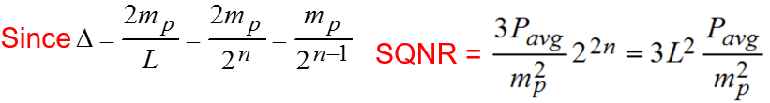
Signal to Quantization Noise Ratio

Slide 43
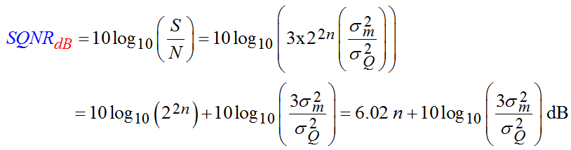
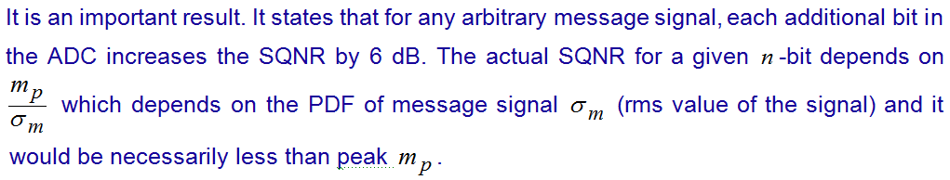
6 dB rule

Slide 44

Case1:

Slide 45


Case2:

Slide 46


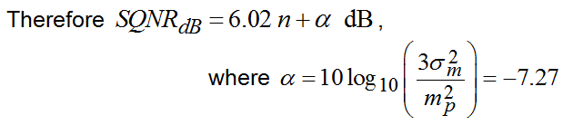
Case3:
Case4:

Slide 47
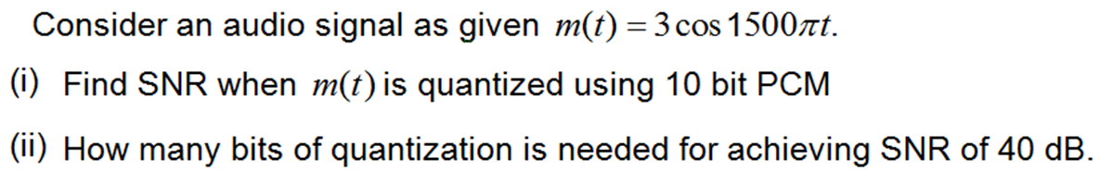
(i) Signal Power
Noise Power

Slide 48
(ii)

Slide 49
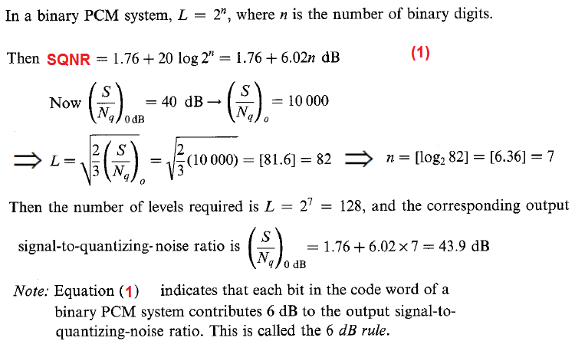
Ex: In a binary PCM system, the output SQNR is to be held to a minimum of 40 dB. Determine the of required levels, and find the corresponding output SQNR.
Ans:

Slide 50
Ex1: Quantize a sequence {1.2, -0.2, -0.5. 0.4, 0.89, 1.3} using a uniform quantizer in the range of (-1.5. 1.5) with (i) Four levels (ii) Eight levels, and write the quantized sequences. Determine the quantization error in each case. Write the encoded sequence. Find the full scale accuracy. Find the percentage accuracy

Slide 51
Given Sequence
{1.2, -0.2, -0.5, 0.4, 0.89, 1.3}
1.125
1.125
01
0.125
10
0.375
01
-0.375
-0.375
00
Bit stream representing Encoding: 11 01 01 10 11 11

Slide 52
Ex1: Quantize a sequence {1.2, -0.2, -0.5. 0.4, 0.89, 1.3} using a uniform quantizer in the range of (-1.5. 1.5) with (i) Four levels (ii) Eight levels, and write the quantized sequences. Determine the quantization error in each case. Write the encoded sequence
(i) For L = 4;
Therefore the quantization error
codewords 00 01 10 11
Quantization levels = { -1.5, -1.125, -0.75, -0.375, 0, 0.375, 0.75, 1.125, 1.5 }
Given Sequence {1.2, -0.2, -0.5. 0.4, 0.89, 1.3}
Therefore the quantized sequence {1.125, -0.375, -0.375, 0.375, 0.125, 1.125}
Bit stream representing Encoding: 11 01 01 10 11 11

Slide 53


(ii) L = 8.
Therefore the quantization error
Quantization levels = { -1.5, -1.3125, -1.125, -0.9375, -0.75, -0.5625, -0.375, 0, 0.375, 0.5625, 0.75, 0.9375, 1.125, 1.3125, 1.5 }
Given Sequence {1.2, -0.2, -0.5. 0.4, 0.89, 1.3}
Therefore the quantized sequence
{1.3125, -0.1875, -0.5625, 0.5625, 0.9375, 1.3125}

Slide 54
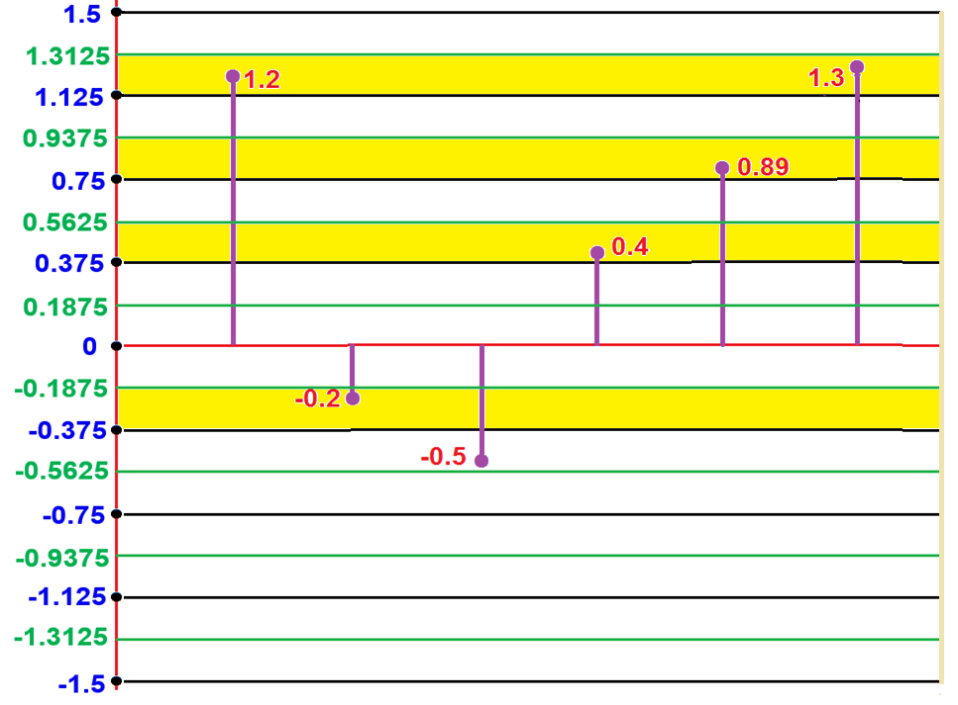


Slide 55
End

